Slide 1
Understanding
r/Depression & r/SuicideWatch
Text Analytics
Chris Fitzgerald, Gabriel James, Hannah Ho, Onyekachi Ugo, Palakh Gupta

Slide 2
A Leading Cause of Disability in U.S. Adults
Strongly correlated with anxiety and panic disorders
Major Depressive Disorder
Typically characterized by an overwhelming feeling of sadness or a loss of interest in most activities > 2 weeks
Affects 16 M American adults every year
50% of suicide victims suffer from MDD
Notes:
Gabe

Slide 3
r/Depression and r/SuicideWatch
“This is a place of support”
“A supportive space for anyone struggling with depression”
Notes:
Gabe

Slide 4
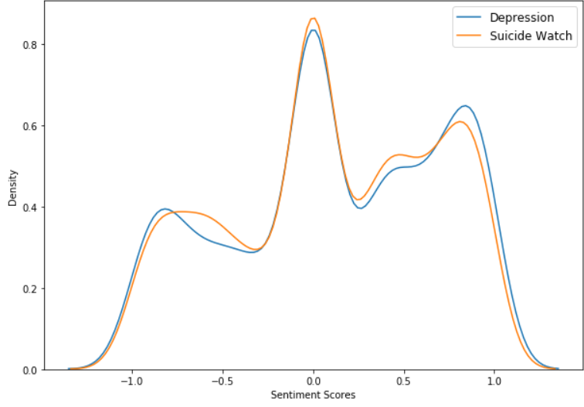
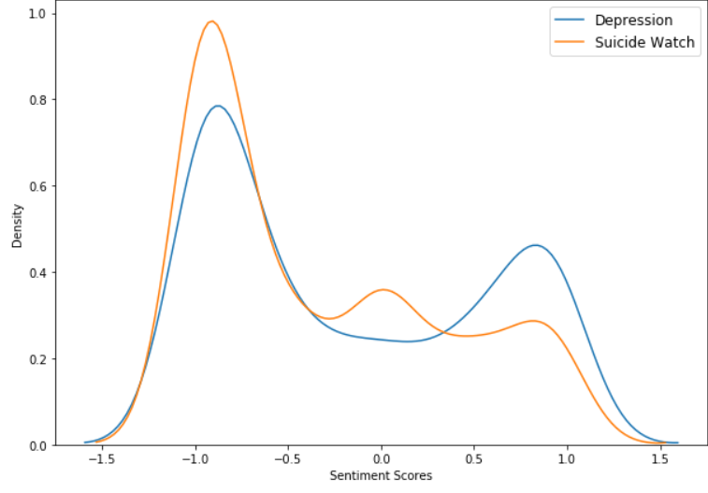
Sentiment Analysis
Comments
Posts
Notes:
Gabe
Comments - similar sentiment
Posts - depression more positive sentiment

Slide 5
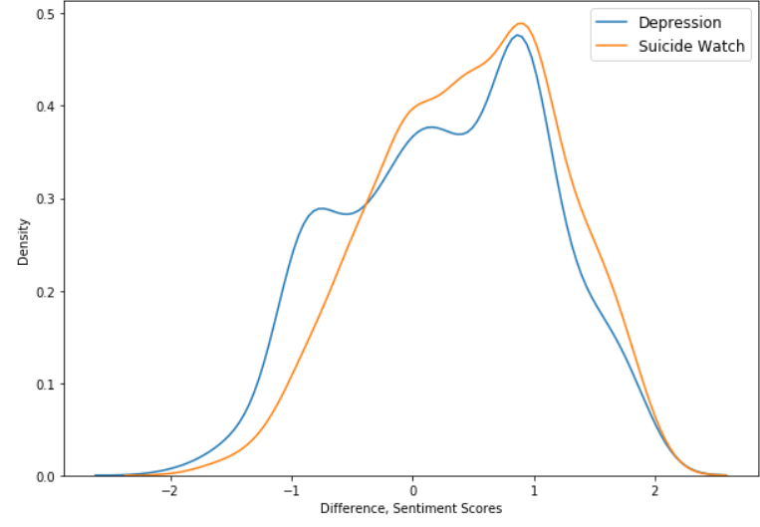
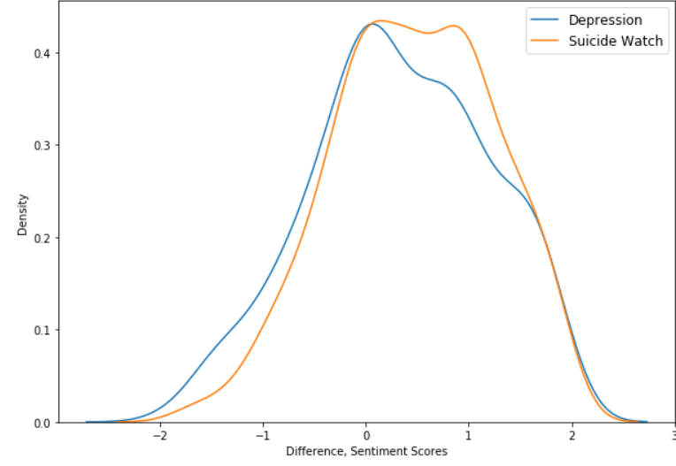
Comments’ Median Sentiment and Post Sentiment
All Comments
Post Replies Only
Notes:
Gabe
Median sentiment minus post sentiment skew positive - sign of supportive community
All comments vs direct replies to post only

Slide 6
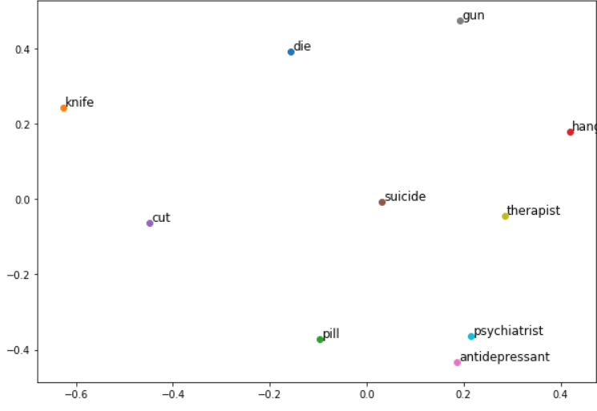
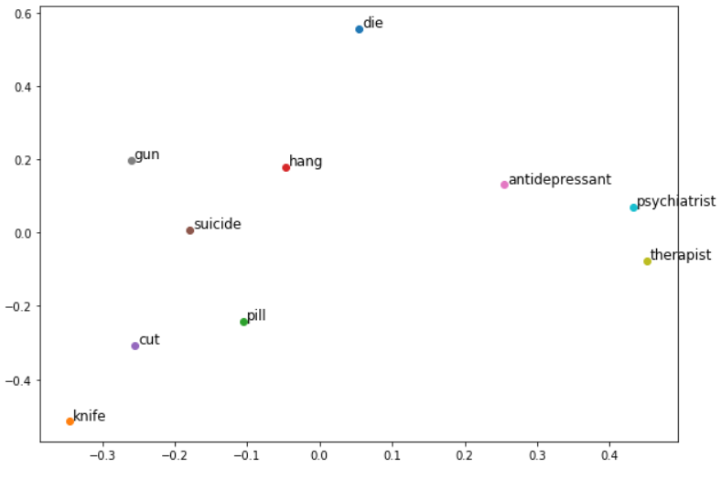
Lifts Among Medical and Suicide Act Terms
r/Depression
r/SuicideWatch
Notes:
Gabe

Slide 7
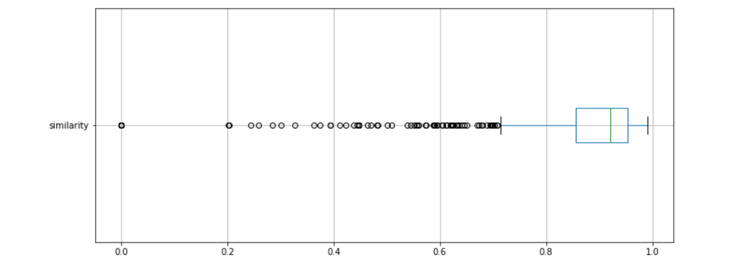
Cosine Similarity
Top 500 words from r/Suicide by TF-IDF score and all r/Depression posts
Notes:
Hannah
500 words with the highest tf-idf scores from the suicide subreddit compared with each post on the depression subreddit

Slide 8
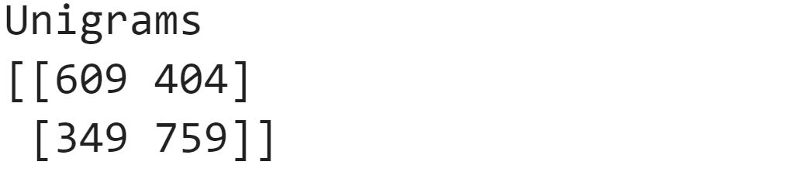
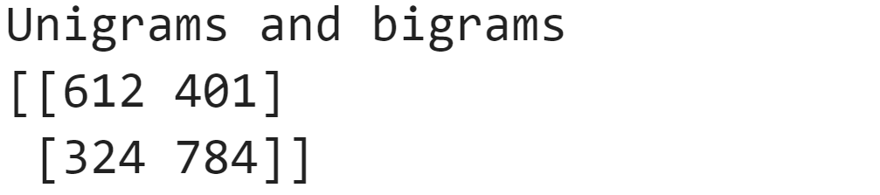
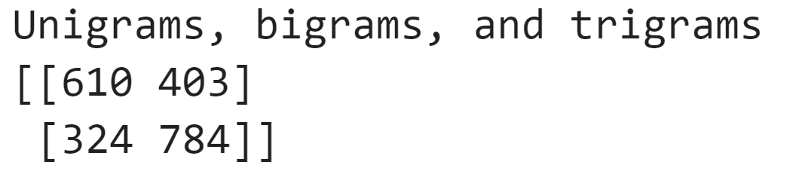
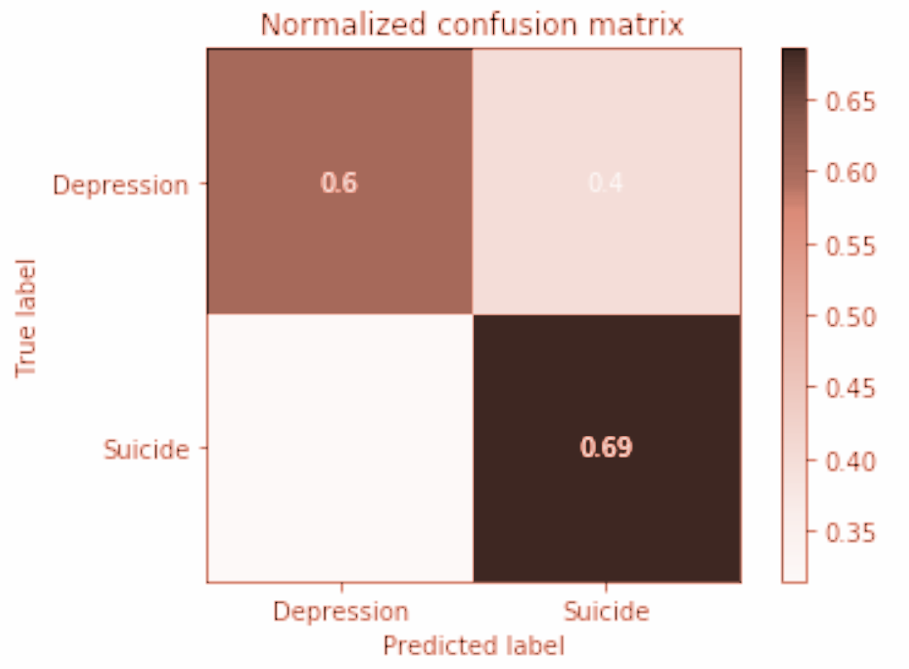
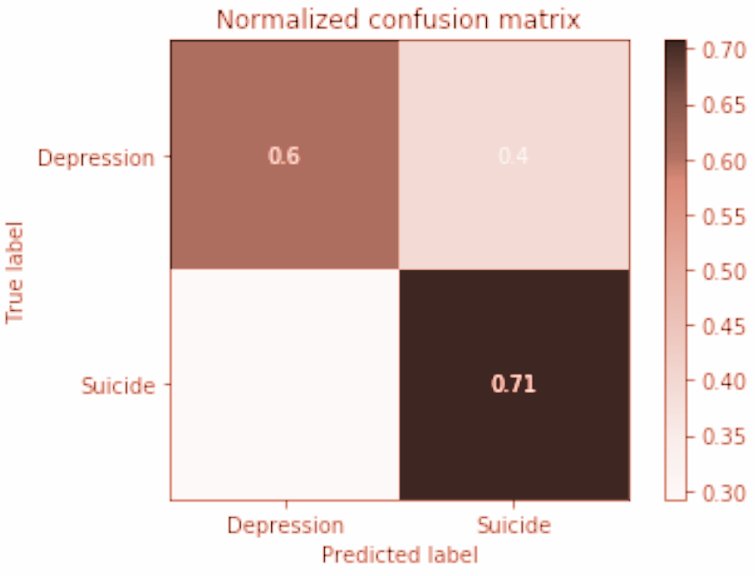
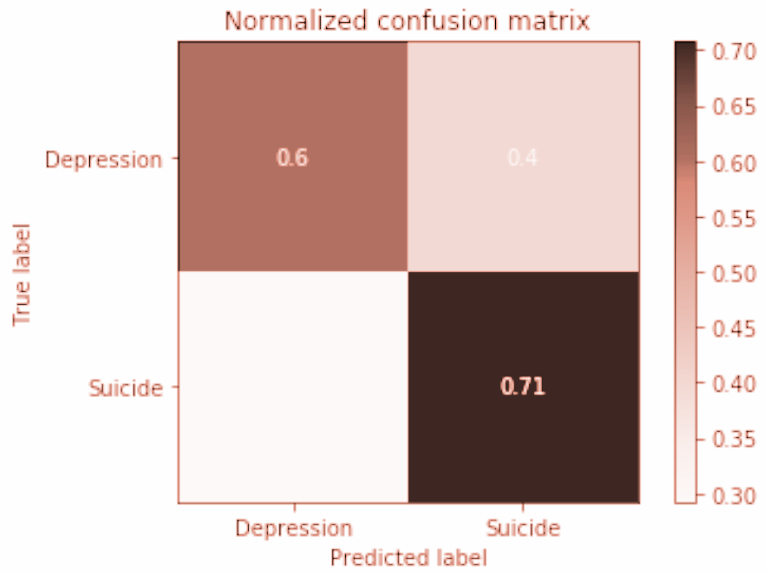
Classifying Comments - Logistic Regression
Interpretable
Top Accuracy: 65.2%
Baseline: 51.2%
Notes:
Hannah
This explains our results when nusing diff combo’s of n-grams tdidf scores to predict which thread a comments comes from. The main takeaway here is that unigrams perform just as well as the larger n-grams.
Tells us that certain unigrams identify the posts well.
Possibly b/c adding bigrams and trigrams increased the number of features from ~4800 to ~24k and ~35k.

Slide 9
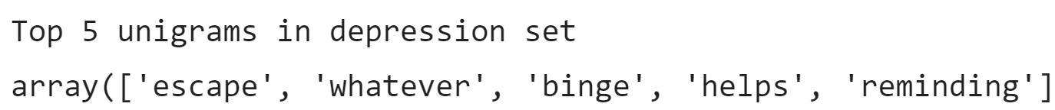
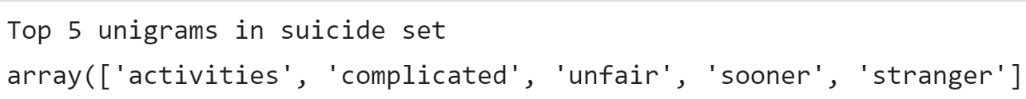
Top Comment Unigrams by TF-IDF Score
Notes:
Hannah
Here are the top 5 words by TF-IDF score. When the words escape, whatever, binge, helps and reminding show up in a comment, it likely comes from the depression thread. When the words …..suicide thread.

Slide 10
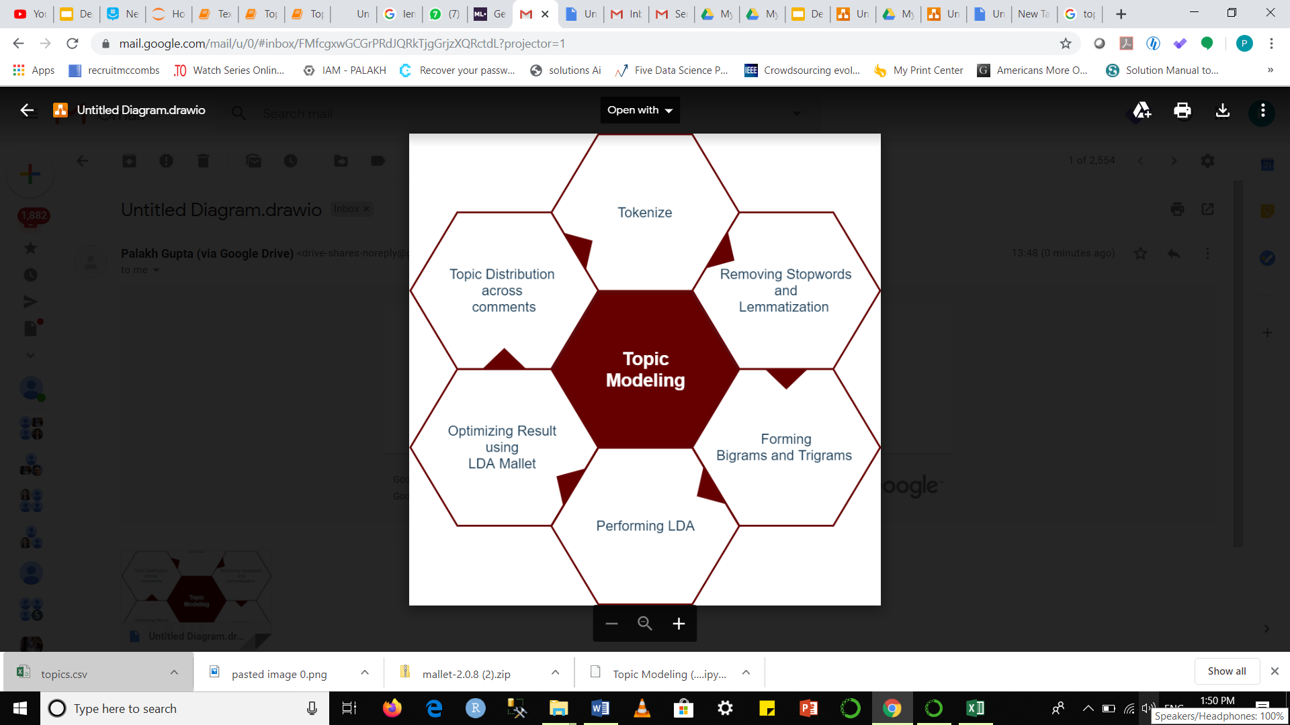
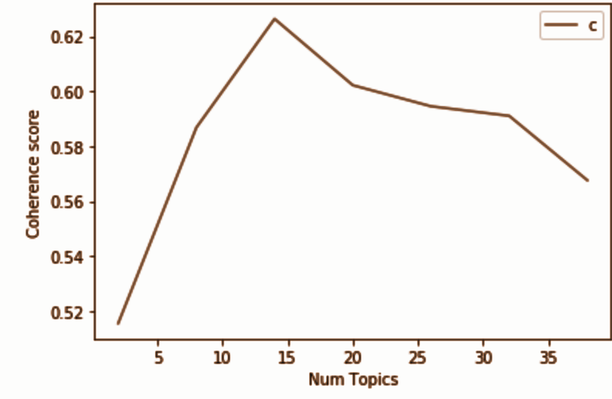
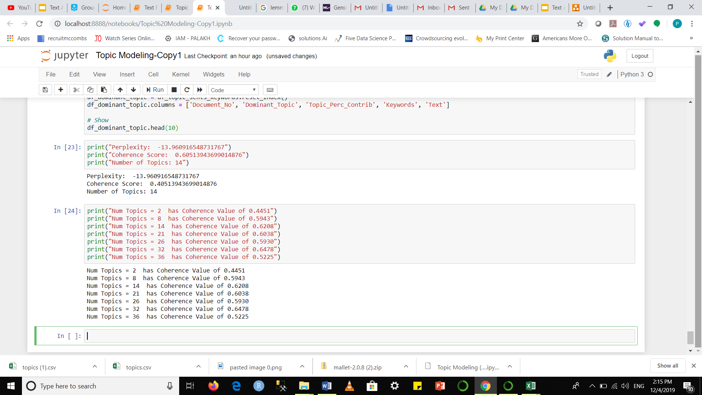
Notes:
Palakh

Slide 11
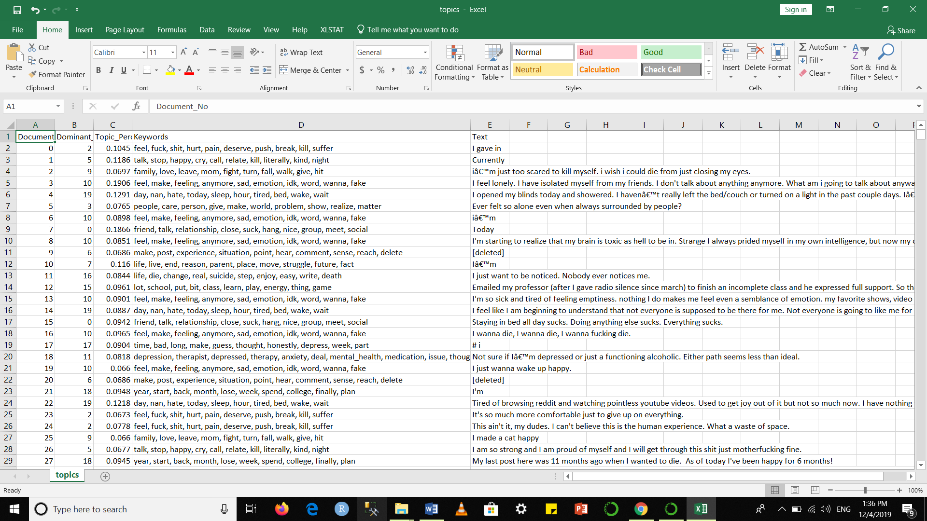
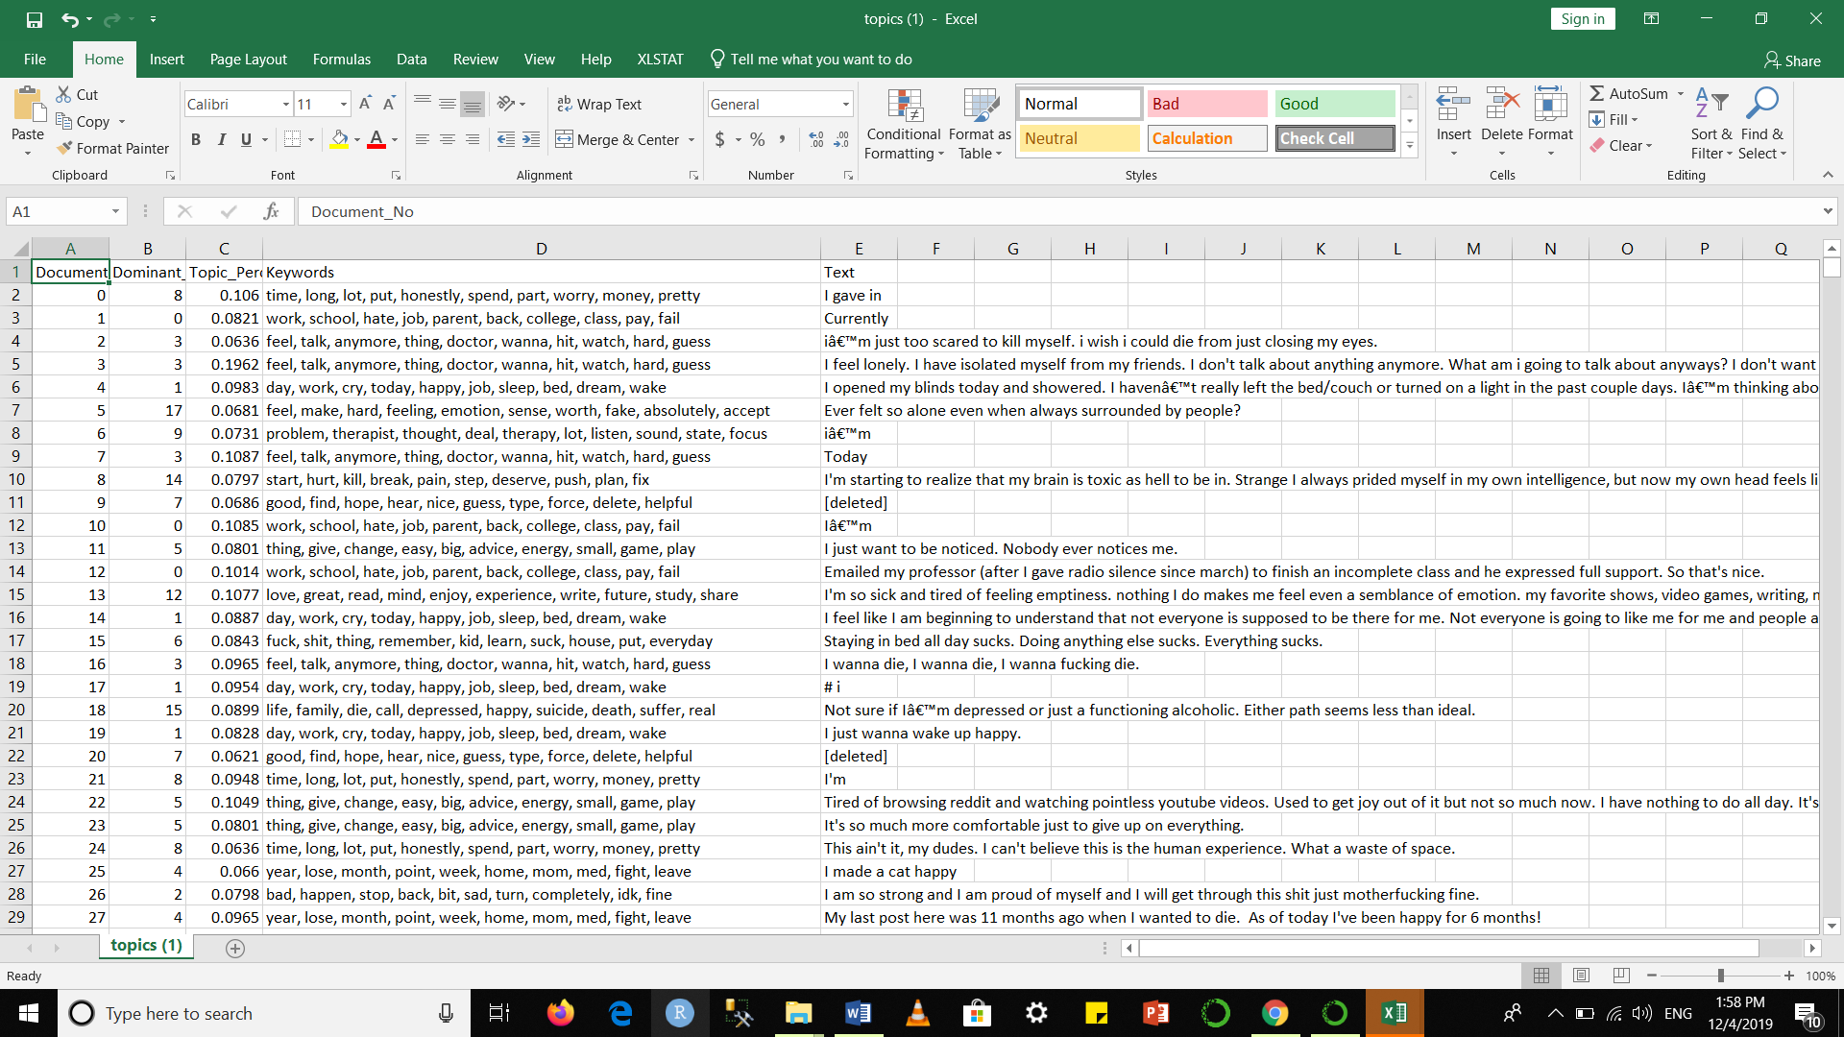
Variation in Dominant Topics
Depression Posts
Suicide Posts
Notes:
Palakh

Slide 12
Insights!
Sentiment analysis shows evidence suggesting the suicide watch subreddit is a healthy/beneficial environment for people who are contemplating suicide and lack offline support
TF-IDF shows top identifying words vary between suicide and depression
LDA shows dominant topics vary between suicide and depression
Depression - Posts more focused on extreme emotions such as sadness, anger, hatred. Many self-harm mentions.
Suicide - Posts more resigned, stoic, and emphasize external influences on decisions

Slide 13
Questions?

Slide 14
Appendix

Slide 15
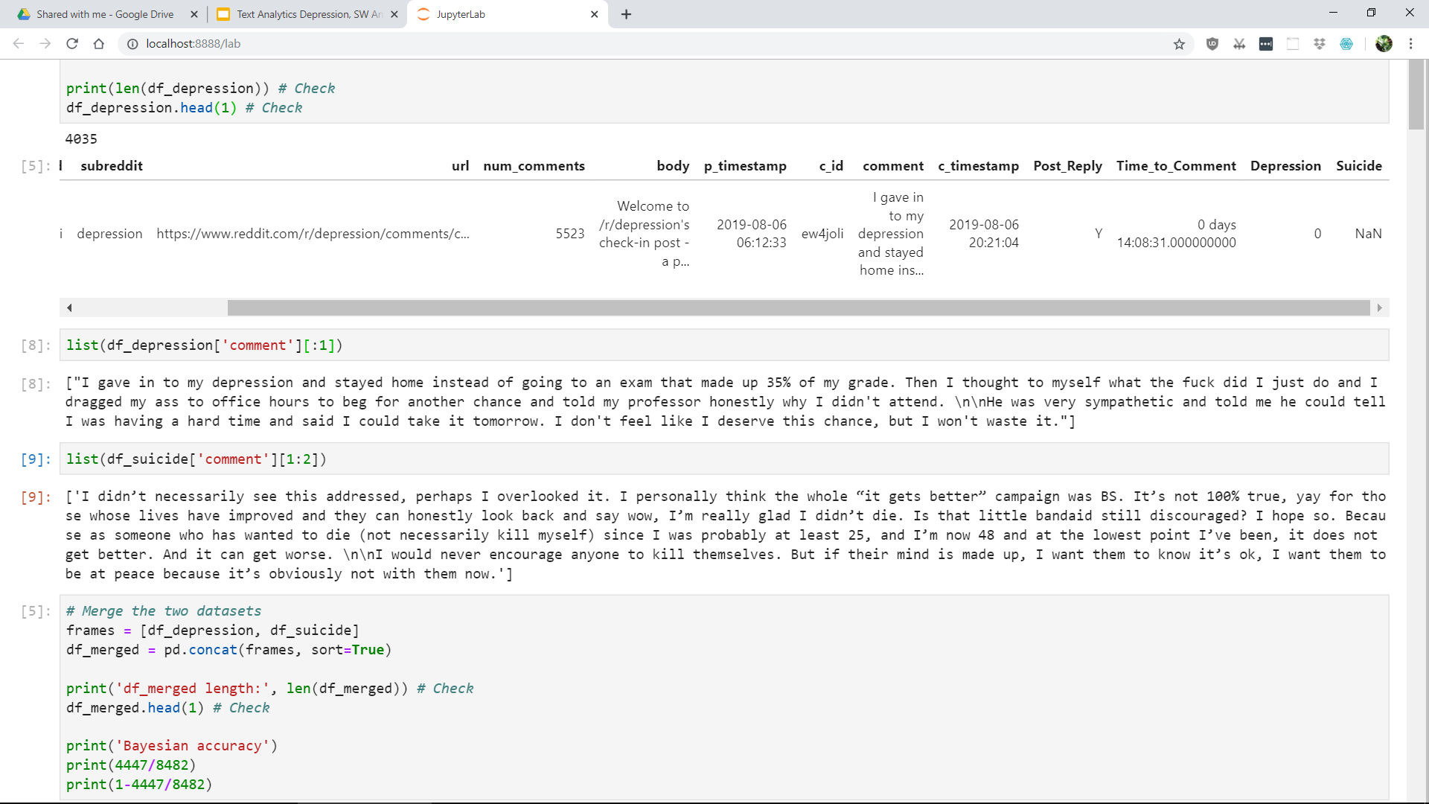
Example Posts

Slide 16
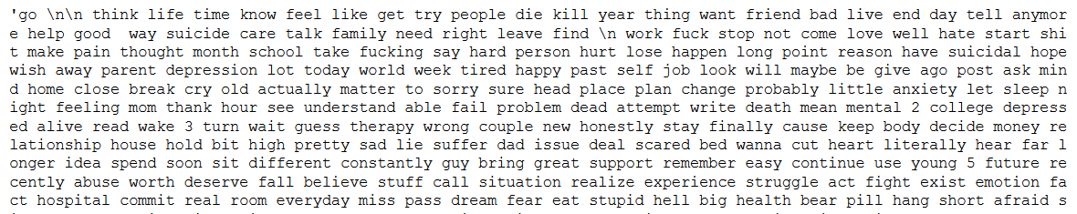
Some of the Top 500 Words used in Cosine Similarity

Slide 17
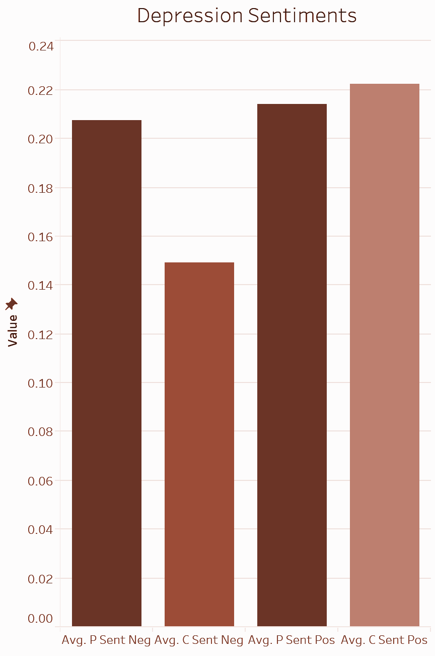
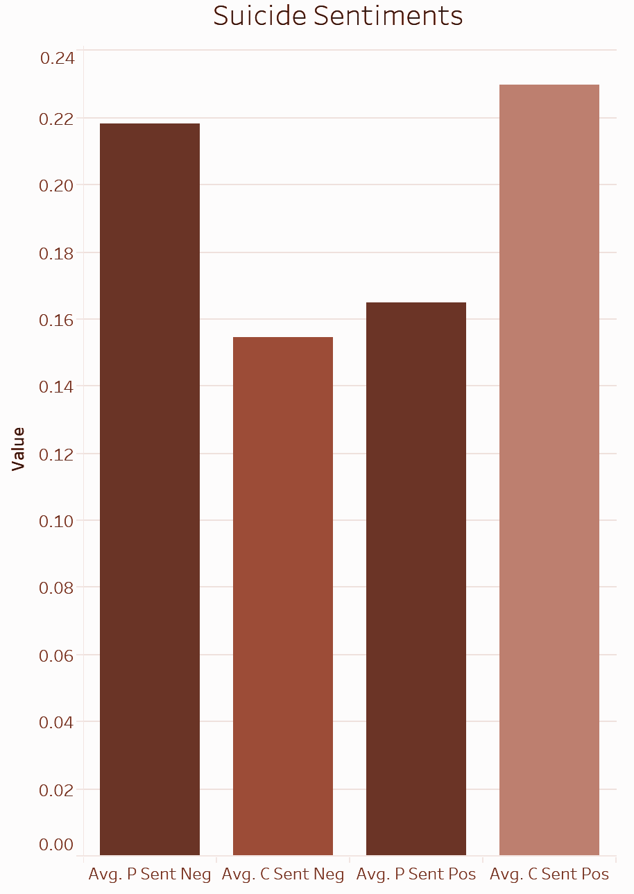

Slide 18
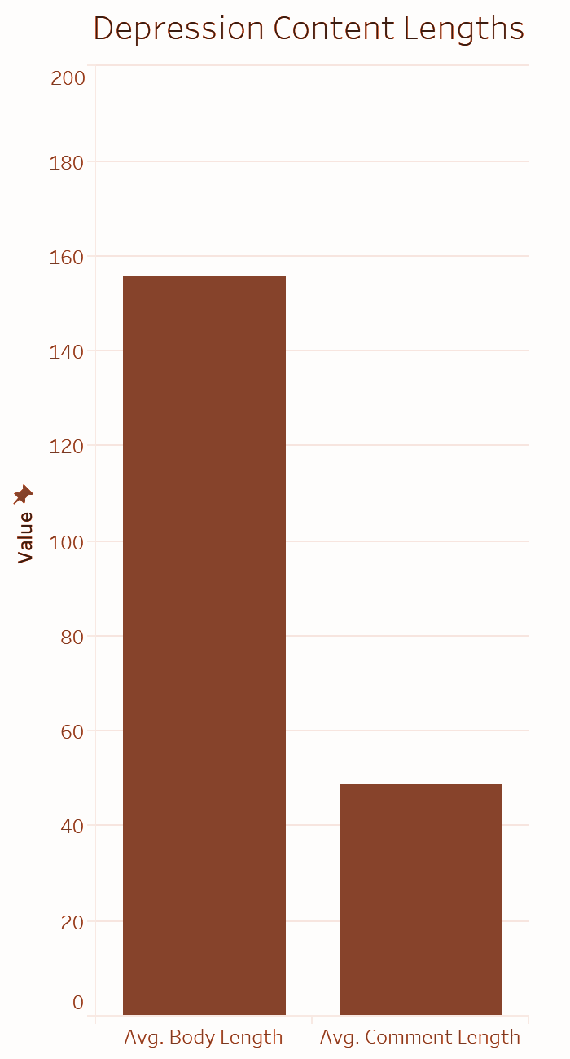
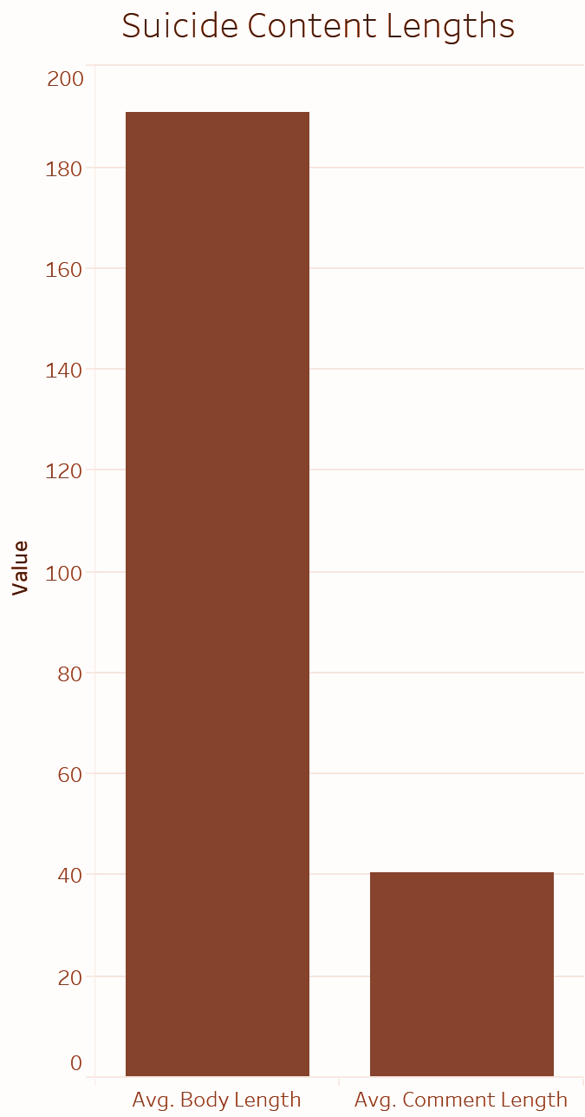

Slide 19
